Slide 1
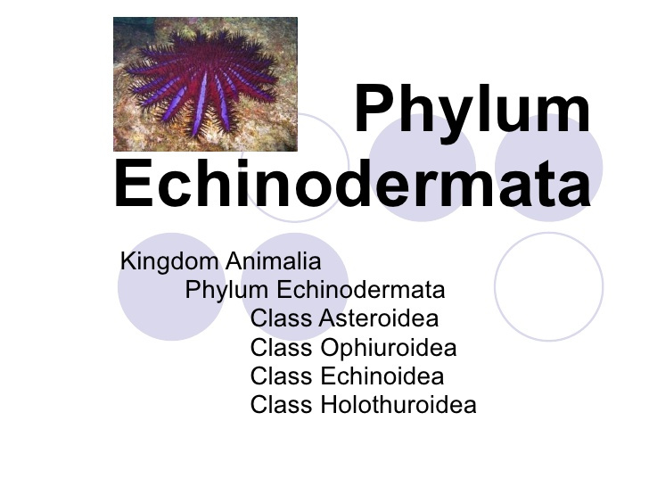

Slide 2
Phylum Echinodermata
Class Asteroidea
Class Ophiuroidea
Class Echinoidea
Class Holothuroidea
Star fish
Brittle star
Sea urchin
Sea cucumber

Slide 3
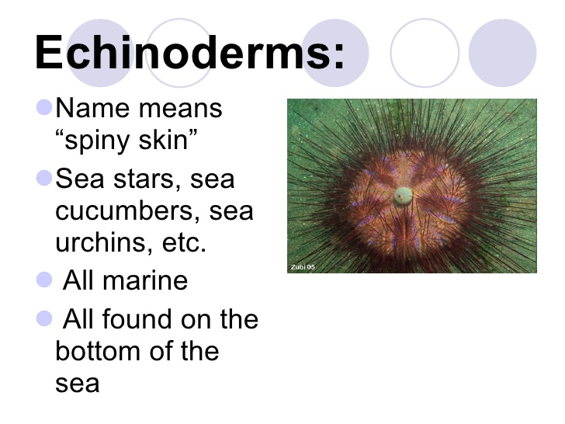

Slide 4
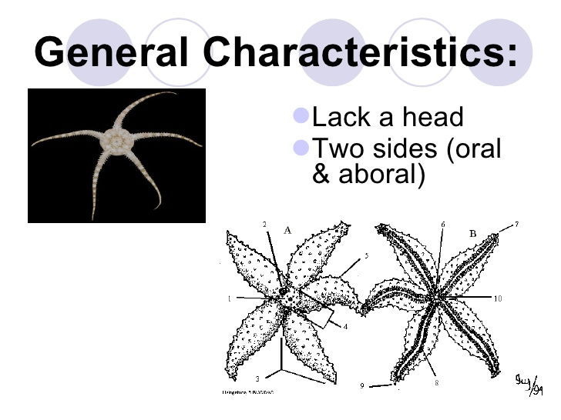

Slide 5
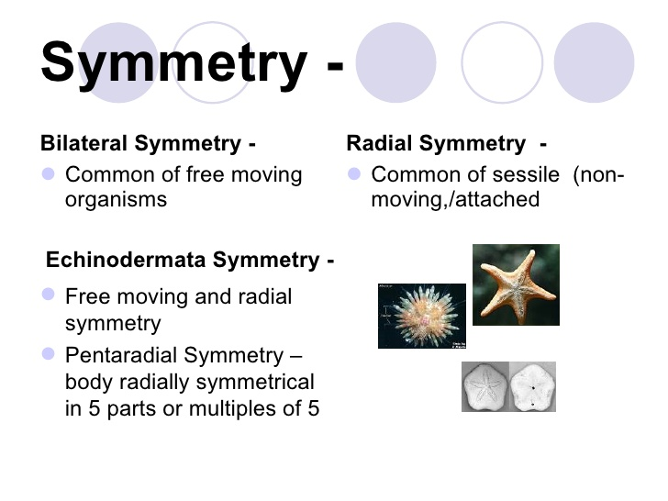

Slide 6
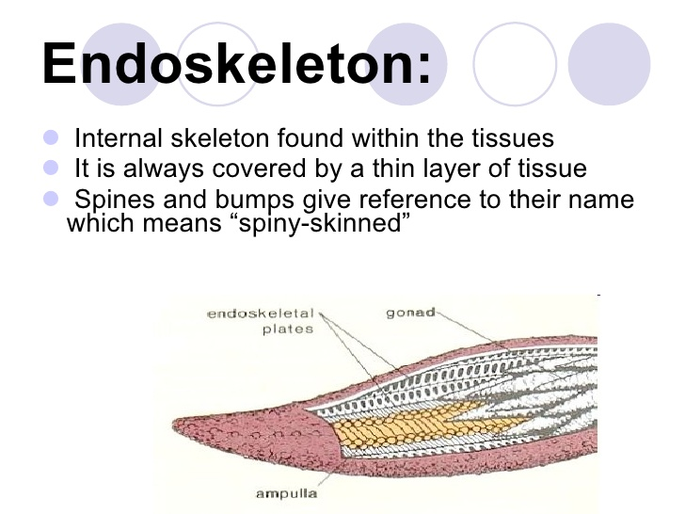

Slide 7
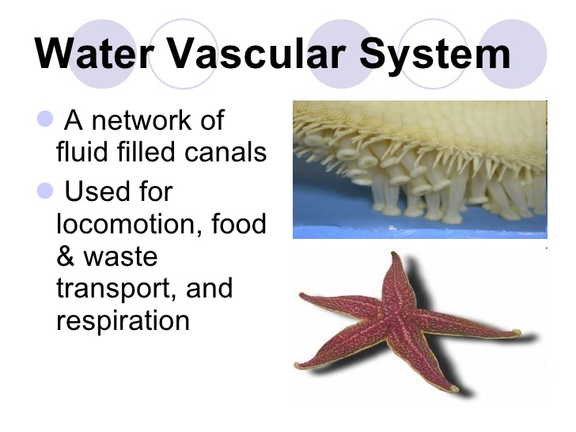

Slide 8
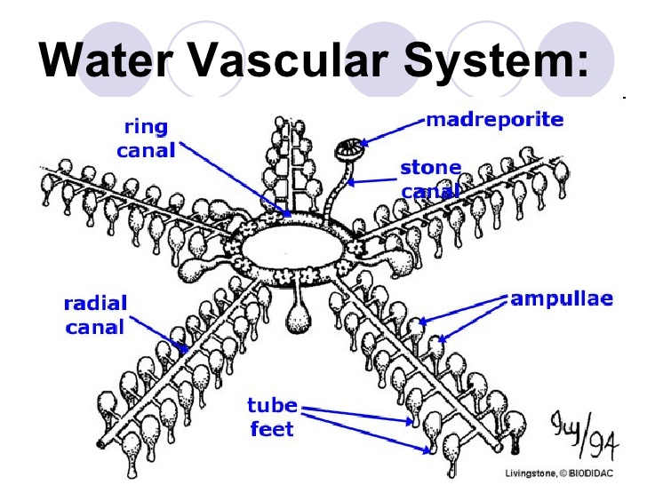

Slide 9
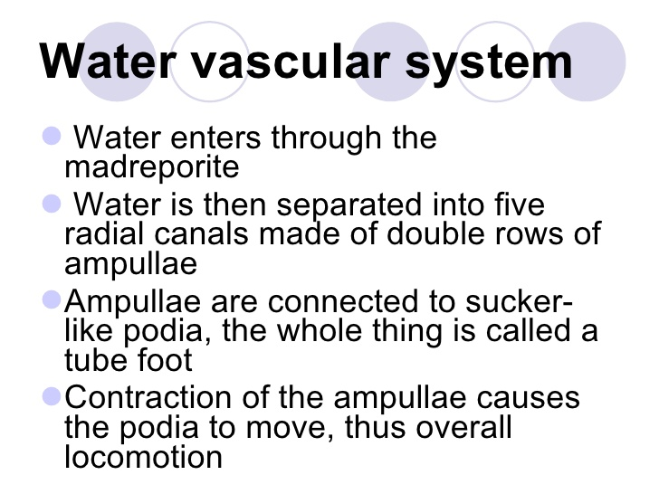

Slide 10
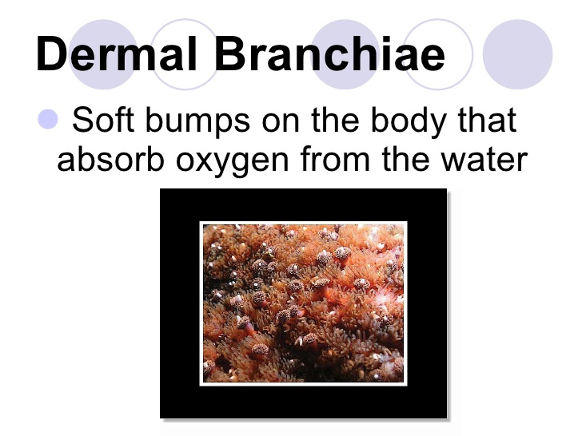

Slide 11
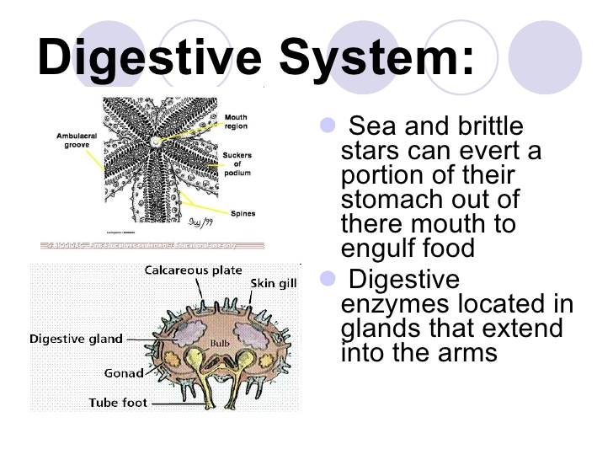

Slide 12
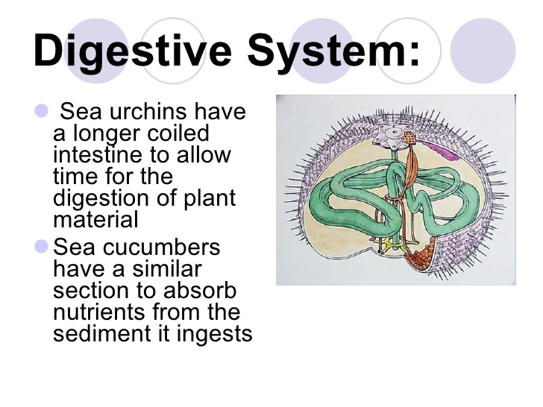

Slide 13
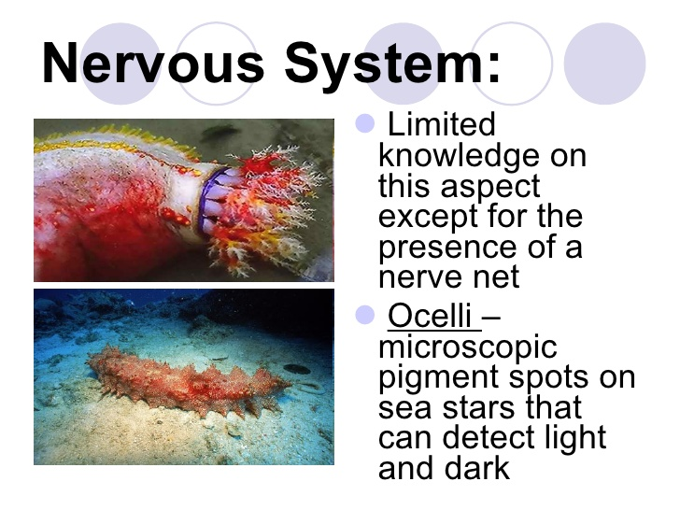

Slide 14
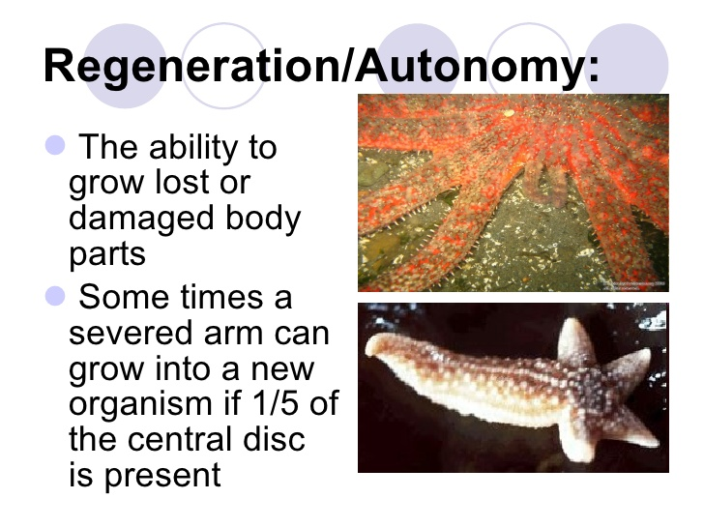

Slide 15
Phylum Echinodermata
Class Asteroidea
Class Ophiuroidea
Class Echinoidea
Class Holothuroidea
Sea star
Brittle star
Sea urchin
Sea cucumber

